Slide 1
Lecture 18
Exception Handling

Slide 2
Representing Exceptions
Two types of Exceptions: 1. Checked Exception 2. Unchecked Exception

Slide 3
Representing Exceptions
ClassNotFoundException
Exception
CloneNotSupportedException
IOException
ArithmeticException
AWTException
NullPointerException
RuntimeException
Object
Throwable
IndexOutOfBoundsException
…
NoSuchElementException
LinkageError
…
VirtualMachoneError
Error
AWTError
Checked
…
Unchecked

Slide 4
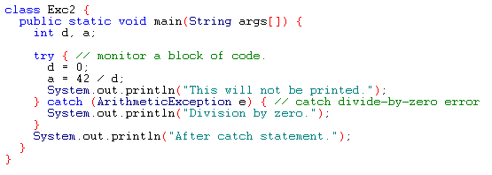
Example
Output:
Division by zero.
After catch statement.

Slide 5
Throw
So far we see exceptions are thrown by the java run-time system.
Throw statement allows an exception to be thrown explicitly.
General Form:
throw ThrowableInstance;
ThrowableInstance must be an object of type throwable or a subclass of throwable.

Slide 6
Example -throw Statements
Output:
Caught inside demoproc.
Recaught: java.lang.NullPointerException: demo

Slide 7
throws
If a method is capable of causing an exception that it does not handle, it must specify this behavior so that callers of the method can guard themselves against that exception
type method-name (parameter-list) throws exception-list
{
// body of method
}
It is not applicable for Error or RuntimeException, or any of their subclasses

Slide 8
Example: incorrect program

Slide 9
Example: corrected version
Output:
Inside throwOne.
Caught java.lang.IllegalAccessException: demo

Slide 10
Checked/Unchecked Exceptions
RuntimeExceptions are need not be included in any method’s throw list. These are unchecked exceptions.
Checked Exceptions must be included in throws list.
Example: ClassNotFoundException, IllegalAccessException etc.

Slide 11
Finally Statement
finally creates a block of code that will be executed after a try/catch block has completed and before the code following the try/catch block.
finally block will be executed whether or not an exception is thrown.
Any time a method is about to return to the caller from inside a try/catch block, via an uncaught exception or an explicit return statement, the finally clause is also executed just before the method returns.
Each try clause requires at least one catch or finally clause.

Slide 12
Example

Slide 13
Output
inside procA
procA's finally
Exception caught
inside procB
procB's finally
inside procC
procC's finally

Slide 14
User Defined Exception
Define a subclass of the Exception class.
The new subclass inherits all the methods of Exception and can override them.
class MyException extends Exception{
private int a;
MyException(int i) { a = i;}
public String toString (){ return “MyException[“ + a+”]”;}
}

Slide 15
Continuation of the Example
class test{
static void compute (int a) throws Myexception{
if(a>10) throw new MyException(a);
System.out.println(“Normal Exit”);
}
public static void main(String args[]){
try{
compute(1);
compute(20);
}catch(MyException e){ System.out.println(“Caught “ +e);
}
}

Slide 16
Example-2
class InvalidRadiusException extends Exception {
private double r;
public InvalidRadiusException(double radius){
r = radius;
}
public void printError(){
System.out.println("Radius [" + r + "] is not valid");
}
}

Slide 17
Continuation of Example-2
class Circle {
double x, y, r;
public Circle (double centreX, double centreY, double radius ) throws InvalidRadiusException {
if (r <= 0 ) {
throw new InvalidRadiusException(radius);
}
else {
x = centreX ; y = centreY; r = radius;
}
}
}

Slide 18
Continuation of Example-2
class CircleTest {
public static void main(String[] args){
try{
Circle c1 = new Circle(10, 10, -1);
System.out.println("Circle created");
}
catch(InvalidRadiusException e)
{
e.printError();
}
}
}

